Slide 1
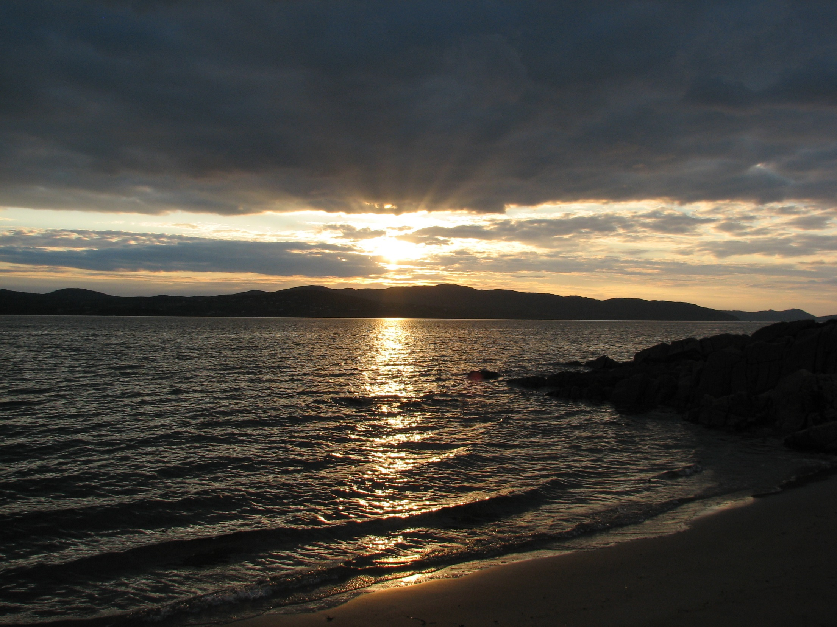

Amazing grace! (how sweet the sound)
That saved a wretch like me!
I once was lost, but now am found,
Was blind, but now I see.

Slide 2

'Twas grace that taught my heart to fear,
And grace my fears relieved;
How precious did that grace appear,
The hour I first believed!

Slide 3
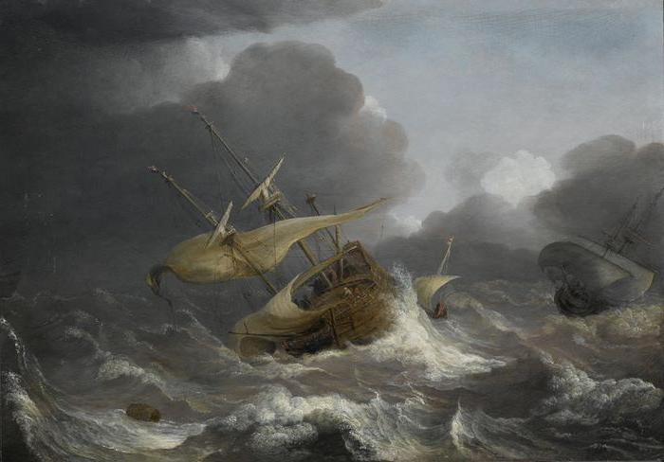
Through many dangers, toils and snares,
I have already come;
'Tis grace has brought me safe thus far,
And grace will lead me home.

Slide 4
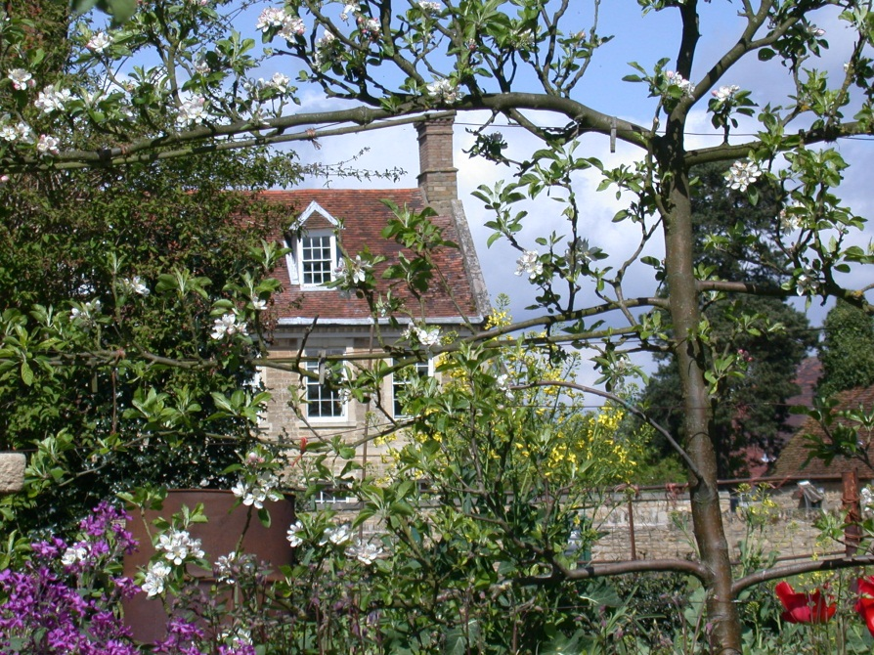
The LORD has promised good to me,
His word my hope secures;
He will my shield and portion be,
As long as life endures.

Slide 5
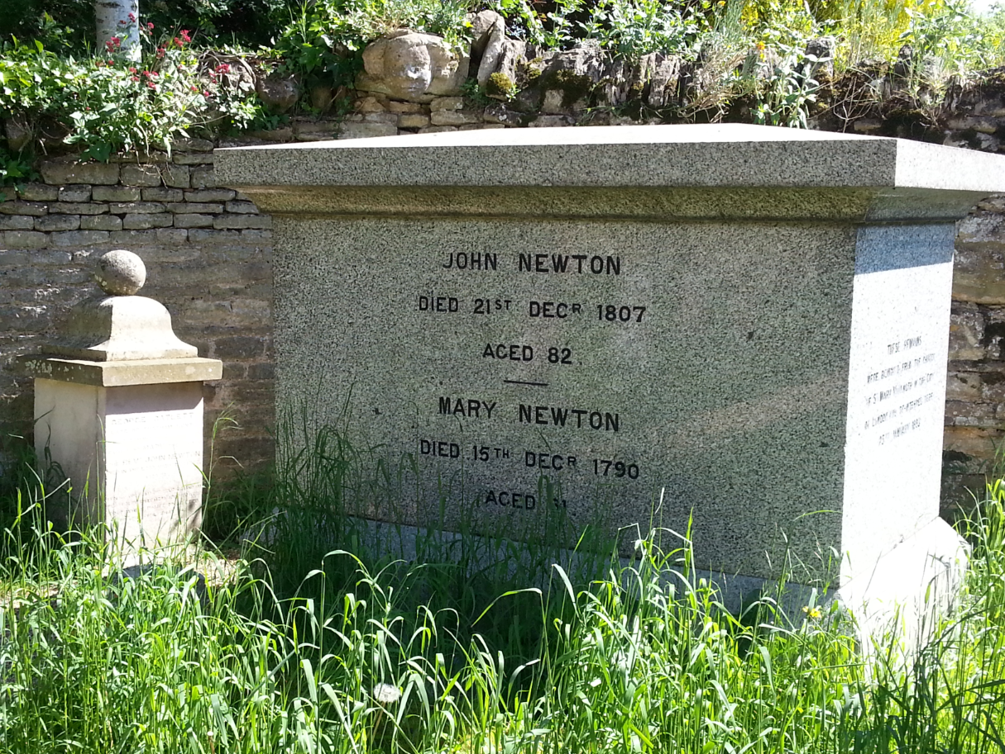
Yes, when this flesh and heart shall fail
And mortal life shall cease;
I shall possess, within the veil,
A life of joy and peace.

Slide 6
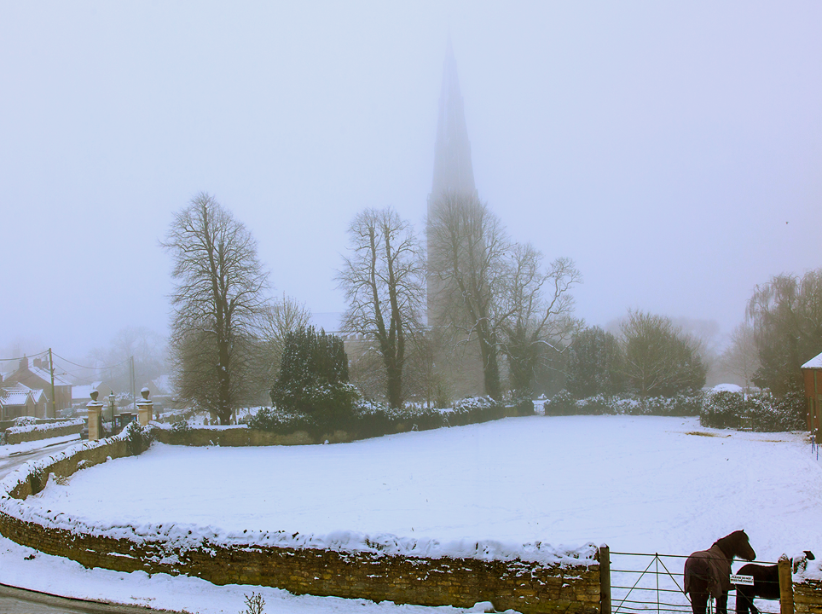

The earth shall soon dissolve like snow,
The sun forbear to shine;
But God, who called me here below,
Will be forever mine.

Slide 7

©
The John Newton Project
2016
www. .org
Acknowledgements:
Cambridge University Library National Maritime Museum
Princeton University Library
Notes:
7
For further information contact:
The John Newton Project
The Hill Lodge
Warwick Road
Stratyford on Avon
CV37 0NP
Tel: 01789 298174
admin@johnnewton.org
www.johnnewton.org

